Slide 1
Machine Learning Recap
Applied Data Analytics for Public Policy

Slide 2
Types of Learning
Unsupervised
Clustering
PCA
…
Supervised
Classification
Regression
…

Slide 3
Supervised learning framework
y
= f( )
X
output
“Learned”
function
Features/Predictors
future/generalization
Training or Learning: Find an f that minimizes error in recovering y
Slide credit: L. Lazebnik

Slide 4
How to solve a prediction problem
Define and Create label (outcome variable)
Define and Create Features (predictors)
Create Training and Validation Sets
Train model(s) on Training Set
Validate model(s) on Validation Set

Slide 5
Python Recap
Define and Create label (outcome variable)
Get people of interest:
We want people who have exited already but are not in prison currently select docnbr from ildoc data (up to today) where admit date > *beginning of time* and latest exit date < *today*

Slide 6
Python Recap
Define and Create label (outcome variable)
Get outcome labels for people of interest:
We want 1 for people who get admitted again within 5 years and 0 otherwise
select case (when admit_date < (*today* + 5 years) then 1 else 0 end) from docnbrs_of_interest left join ildoc.ildoc_admit_after_today
Docnbr (fake) | Label (5 years)
212344235 | 0
424324555 | 1
434299999 | 1

Slide 7
Python Recap
Define and Create Features
Get people of interest
Get date (to create features as of)
Generate features select features from data where date < as_of_date
Docnbr (fake) | As_of_Date | Current_age | # of times admitted in the past 2 years
212344235 | 1/1/14 | 32 | 0
424324555 | 1/1/14 | 19 | 1
434299999 | 1/1/14 | 65 | 1

Slide 8
Create Training and Validation Sets
Data
1989 2016
Training Set
Features
Labels
1989 2006 2011
Test Set
Features
1989 2011 2016
Labels

Slide 9
Create labels and Features for Training and Test Sets
create_labels (2006, 5 years)
create_features (2006)
Train_matrix = join of the two above
create_labels (2011, 5 years)
create_features (2011)
test_matrix = join of the two above

Slide 10
Train model(s) on Training Set
Define feature columns X_train
Define outcome column y_train
Fit model
Model_type = LogisticRegression
Fitted_model = Model.fit(X_train, y_train)

Slide 11
Test model(s) on Test Set
Define feature columns X_test
Define (known) outcome column y_test
Score data using fitted model
Scores = Model.predict_proba(X_test)
Docnbr (fake) | scores
212344235 | 0.3
424324555 | 0.8
434299999 | 0.9

Slide 12
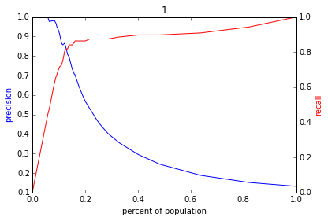
Validate model(s) on Validation Set
We have known outcomes (y_test) and predicted scores
Turn scores into 0 or 1 using a threshold
Calculate metrics
Precision and recall at k graph
Calculate_precision_recall_at_k (scores, y_test, threshold)

